Slide 1

Inventory Analysis Software
Presented by
Lekha Vibhudi
Shreyah Gurram
Abhinaya Vaitla
Sowmya Oleti
Mansi Singh
Guided by: Debashree Mishra

Slide 2
Index
Aim of the project
Introduction
Objectives
Software Requirements
Flowchart
Implementation
Advantages
Conclusion

Slide 3
Aim of the Project
To develop an Inventory Analysis Software using c programming.
Applicable for large as well as small group of business e.g. a small-scale business entity using online platform to meet public needs.

Slide 4
Introduction
Inventory Analysis software is a software system for tracking inventory levels, orders, and sales.
As businesses move away from pen and paper processes to automated solutions, visibility becomes a key factor in inventory analysis.
Companies use inventory analysis software to avoid product overstock and outages.
It is a tool for organizing inventory data that before was generally stored in hard-copy form or in spreadsheets.
It’ll show you which products were the most popular and what items didn’t sell as well as you’d hoped.

Slide 5
Objectives
To maintain independence of operations.
To meet variation in product demand.
To allow flexibility in product scheduling.
To balance various costs of inventory.
Conduct a periodic cycle count to track stock.

Slide 6
Software Requirements
This inventory analysis is coded and made using the following:
Operating system: Linux
Software : Ubuntu
Back-end: C programming

Slide 7
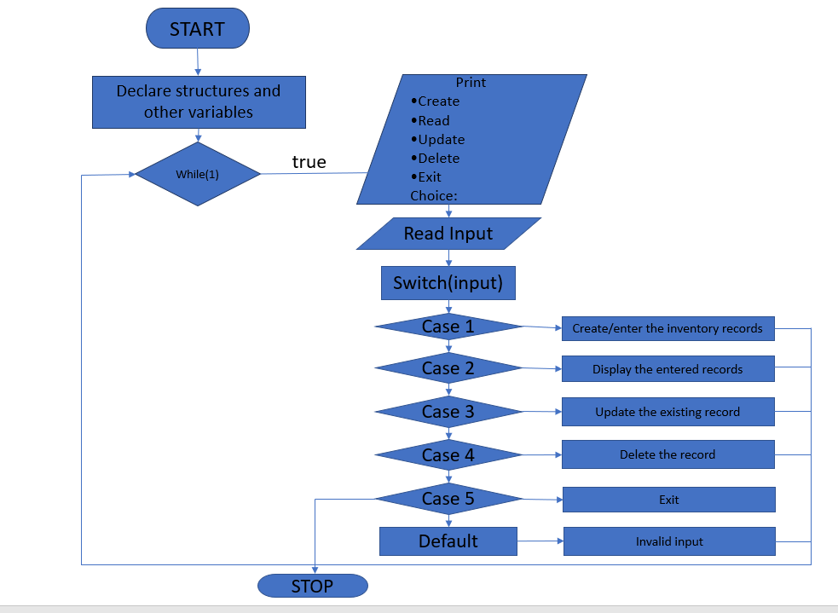
Flow chart of Inventory Record

Slide 8
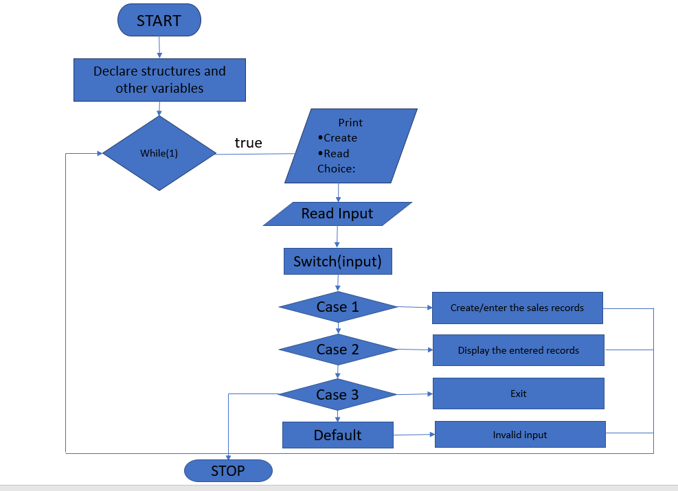
Flow chart of Sales Record

Slide 9
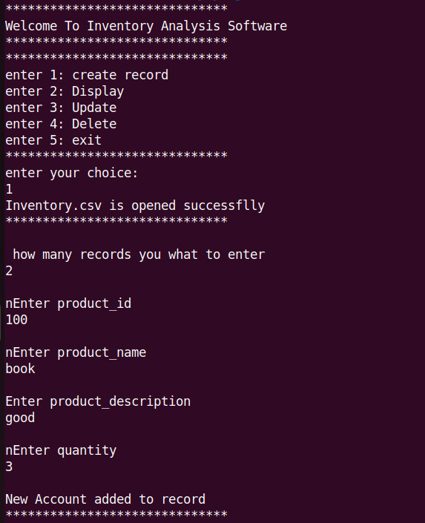
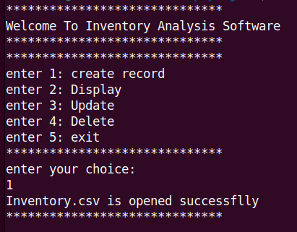
Implementation
After Execution the screen appears like this:

Slide 10
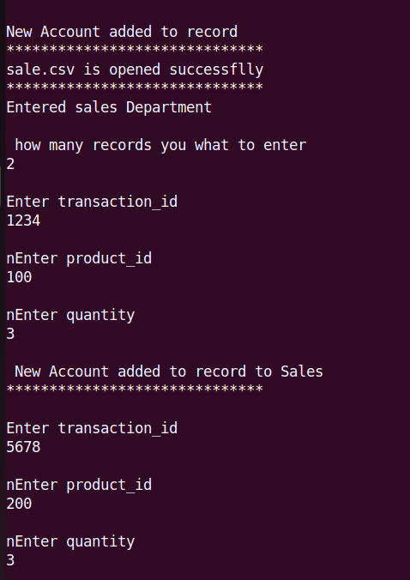
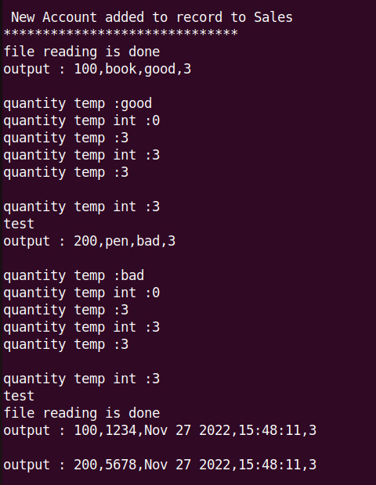
Implementation
is valid

Slide 11
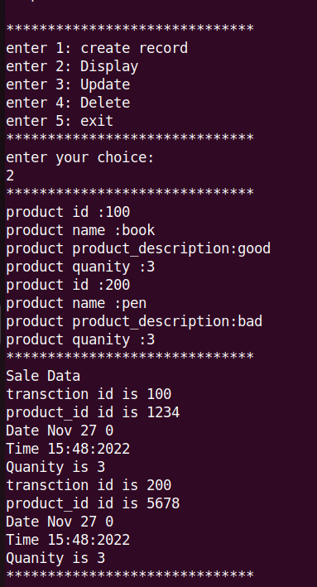
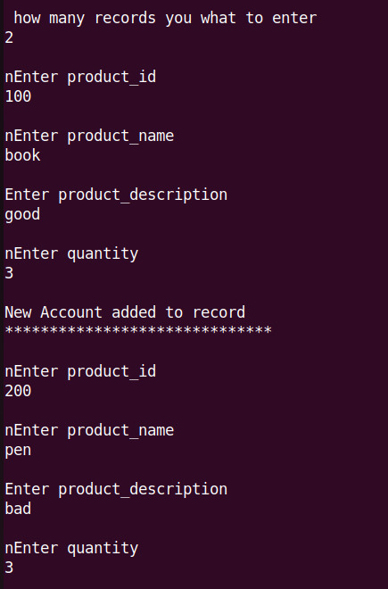
Implementation
After giving the input as per the requirement:

Slide 12
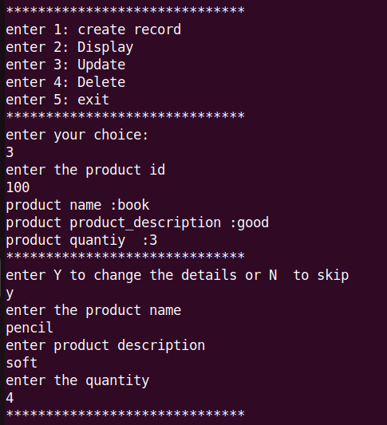
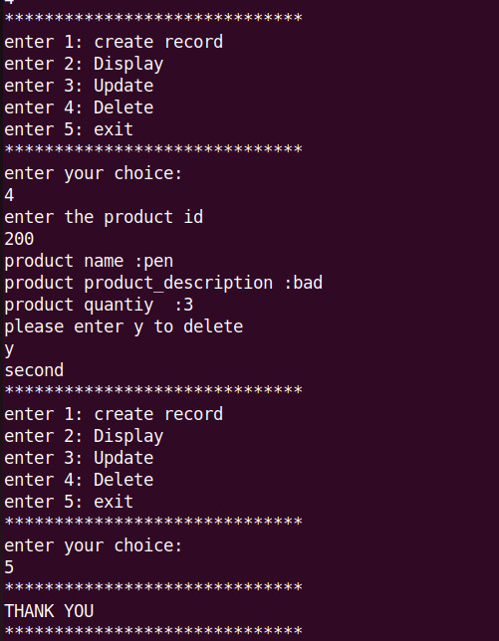
Implementation

Slide 13
Advantages:
Improved accuracy.
Increased productivity.
Data Security.
No more manual work.

Slide 14
Conclusion:
Managing stock is a hard job. But managing stock correctly is a considerably harder job.
When you have a stock & inventory analysis software in your stockroom, there are many advantages you'll get that aren't constrained.
Simply put, an inventory analysis software that assists in controlling and balancing the flow of incoming and outgoing products.

Slide 15


